Slide 1
Network-On-Chip For Neurological Data
Neuralink, US2019/0286592, 3/14/2019
_{3/11/2024}

Slide 2
How to Retrieve Data from the Brain
Purpose: To retrieve & process neurological events in the brain as captured by electrodes
Embodiments:
  Multi-Chip Implementation
  Linear Chip Implementation
  2 Custom Chip Implementations
  2 Data Packet Architectures

Slide 3
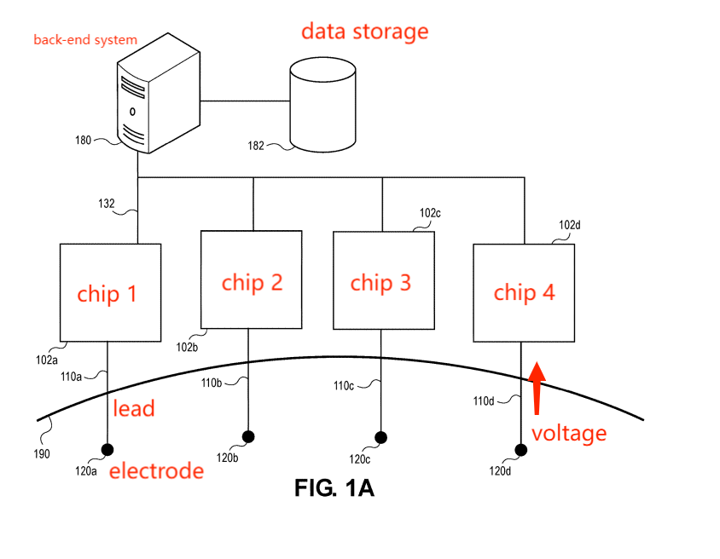
Multi-Chip Implementation (Parallel Circuit)

Slide 4
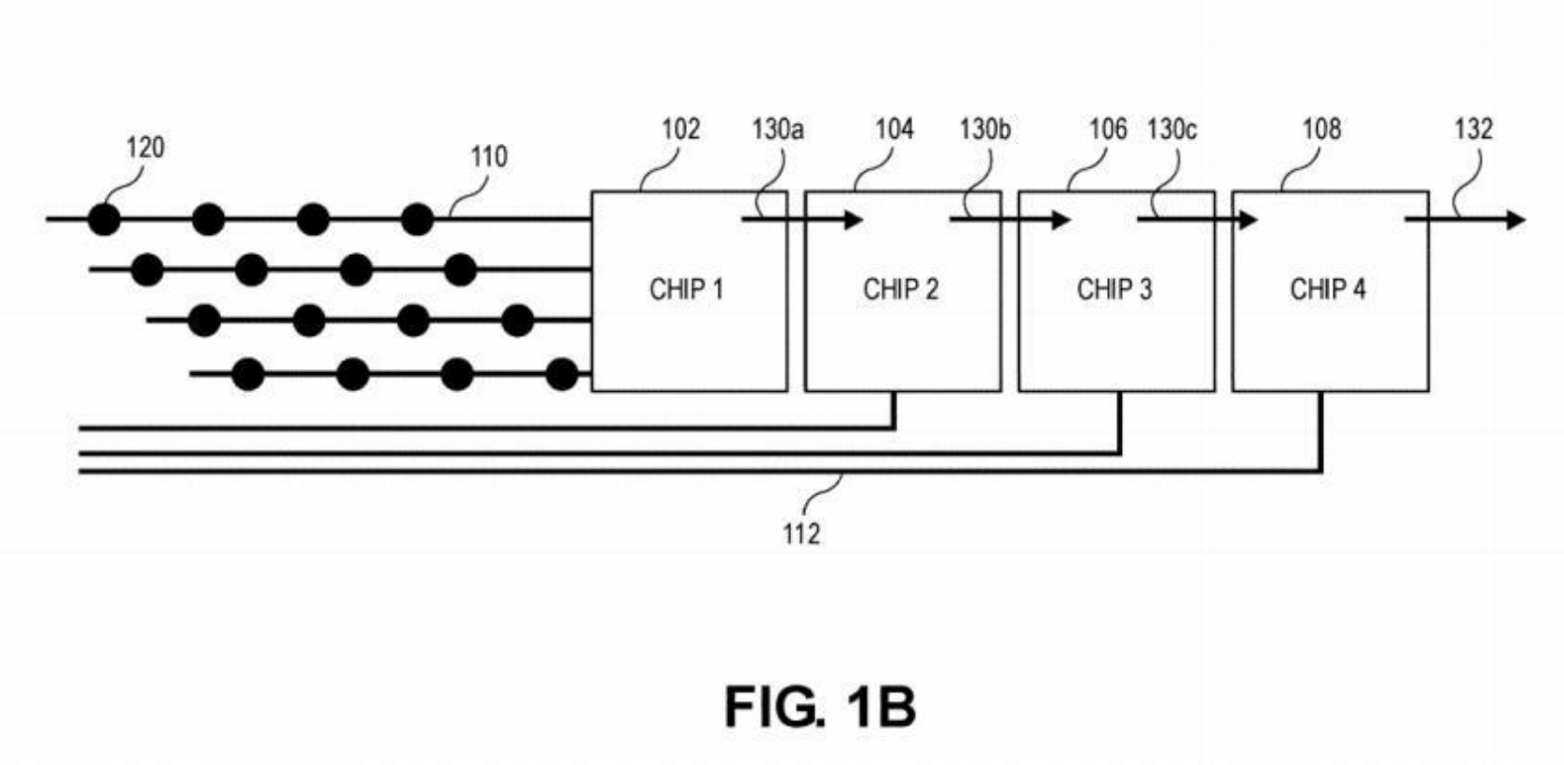
Linear Chip Implementation

Slide 5
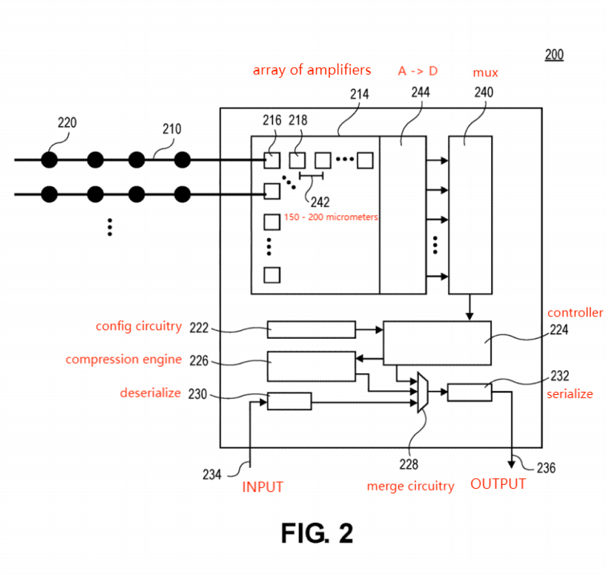
Custom Chip Implementation 1

Slide 6
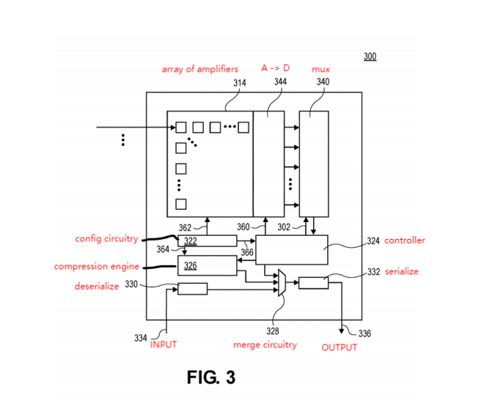
Custom Chip Implementation 2
Event handling: Can decide which events received neurological signals to process by setting thresholds - indicative of particular type of neurological event (ex. neuron firing only signals past a threshold are worth handling)

Slide 7
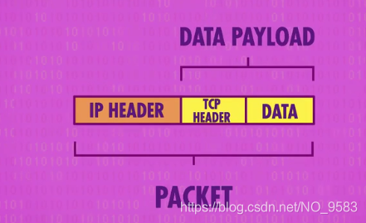
Concept: Data Packet
Units of information collected into one set for transmission through internet

Slide 8
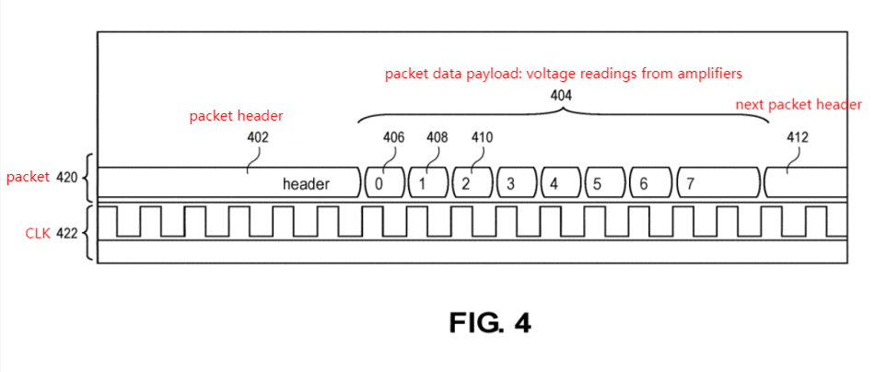
Data Packet Architecture 1

Slide 9
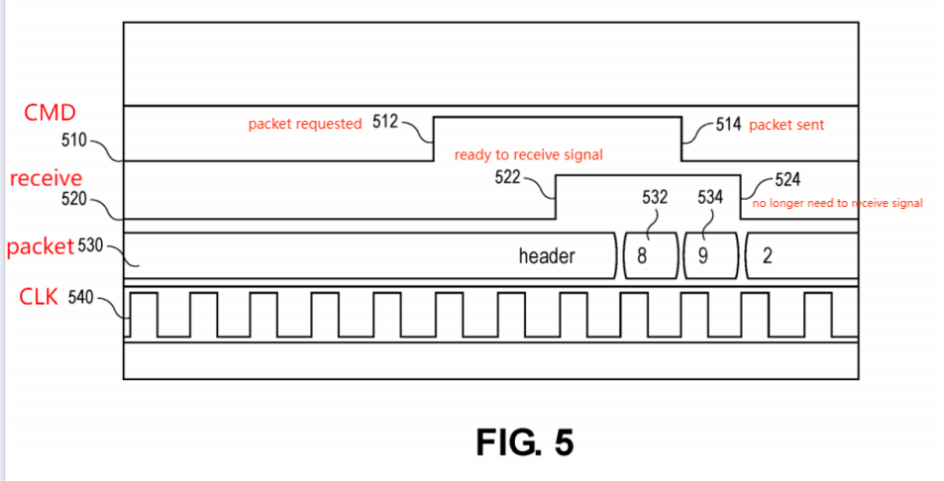
Data Packet Architecture 2

